Slide 1
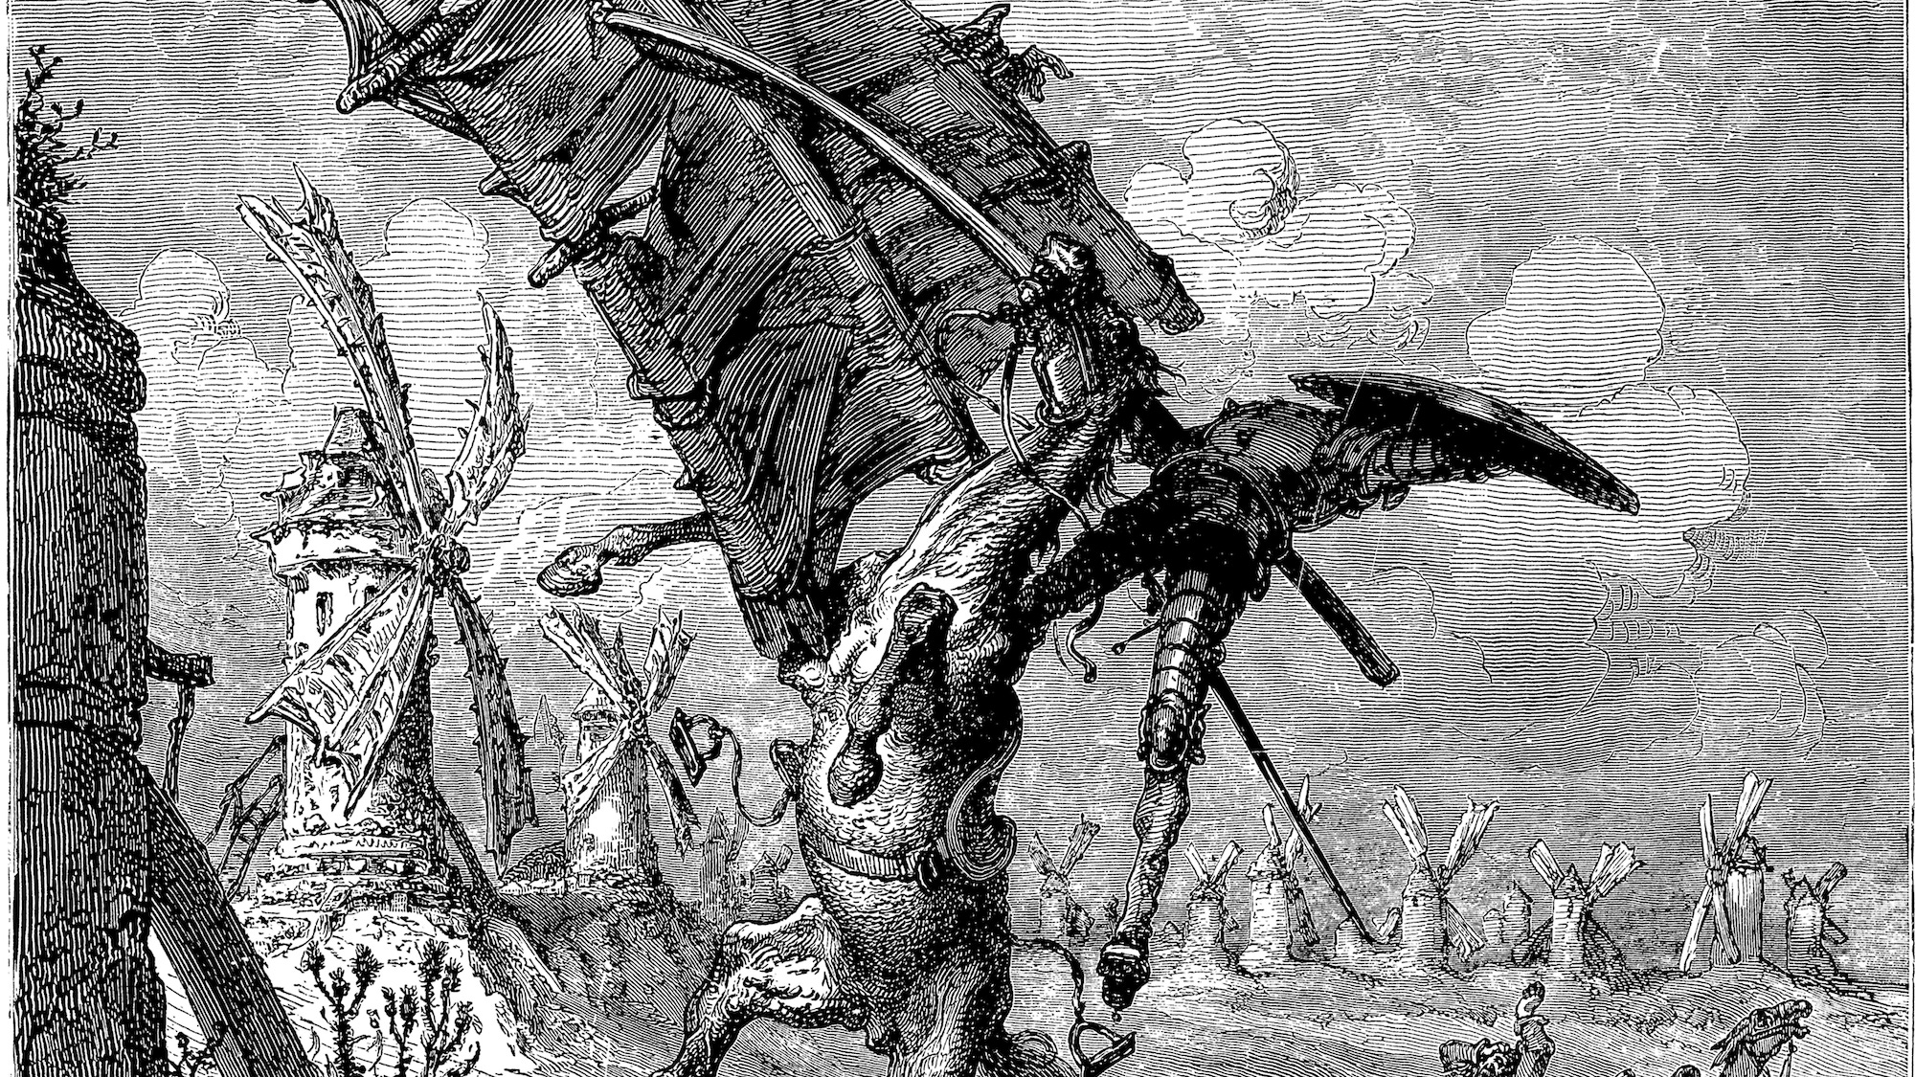
Reproducibility in an Office World
Noam Ross,
R-Ladies NYC 2018-11-06
@noamross
A Brief History of Failures and the Odd Success

Slide 2
First: Have you voted?
It’s OK, you have two more hours.
Leave now.

Slide 3


@EcoHealthNYC
@rOpenSci

Slide 4
The Two Realms of Workflows
Programmatic
Linear
Centralized
Automated
Interactive
Iterative
Decentralized
Manual

Slide 5






The Two Realms of Workflows

Slide 6
Valley of Heartbreak

Slide 7
The First Path: Warpath Across the Valley
“I know, I’ll teach everyone in my organization git!”
[or R, or markdown, or…]

Slide 8
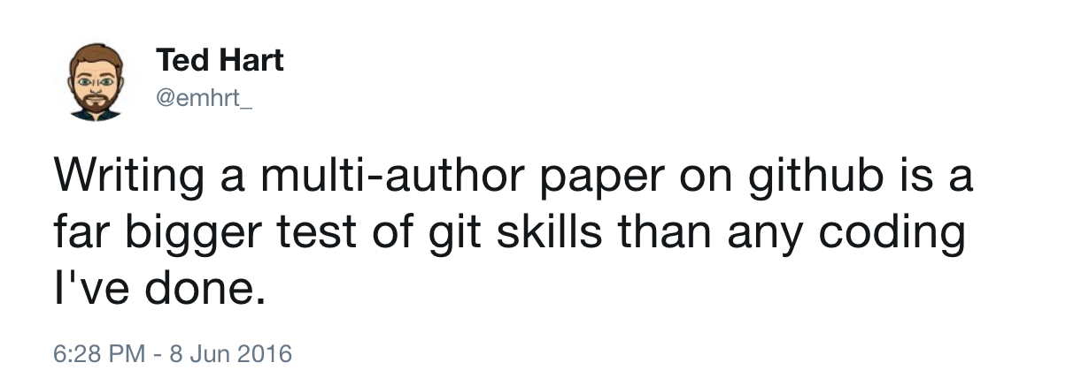

Slide 9
The Second Path: A Grand but Shaky Bridge
A web-based GUI editing interface
A continuous integration setup to compile
A beautiful R Markdown template
A Heroku app to host compiled docs behind a Google OAuth

Slide 10
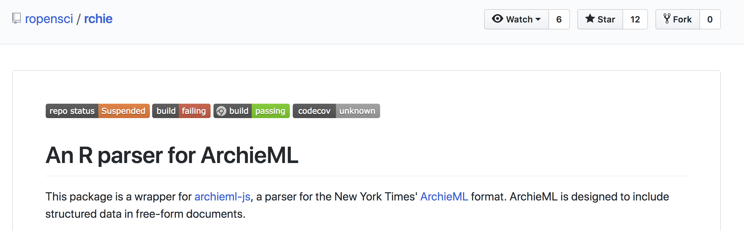

“ Structured text, for an unstructured world.”

Slide 11
Web and programmatic outputs
Documents and further iterated outputs

Slide 12
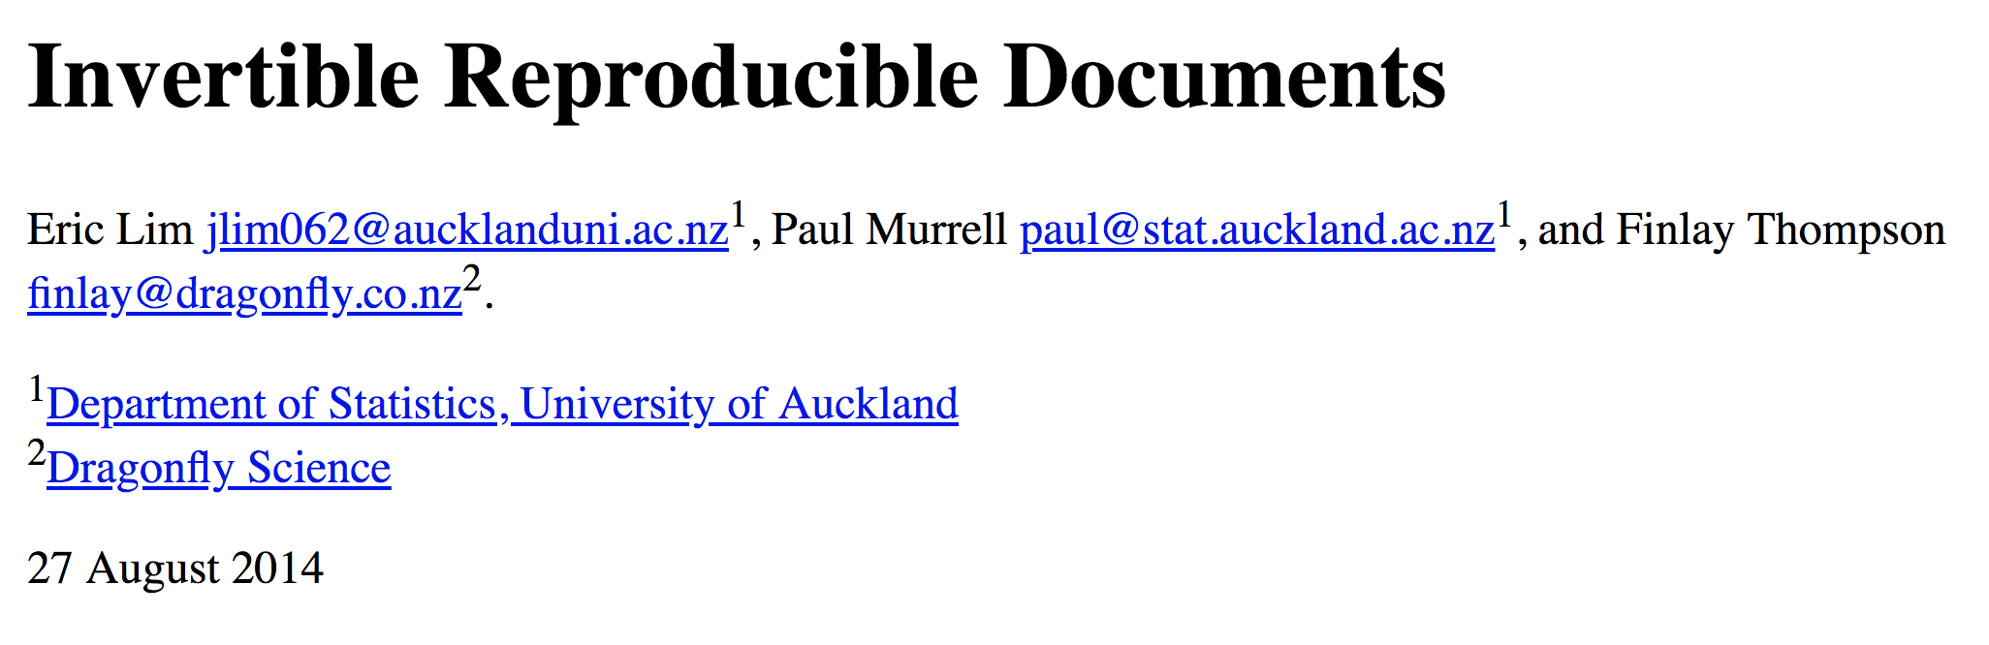
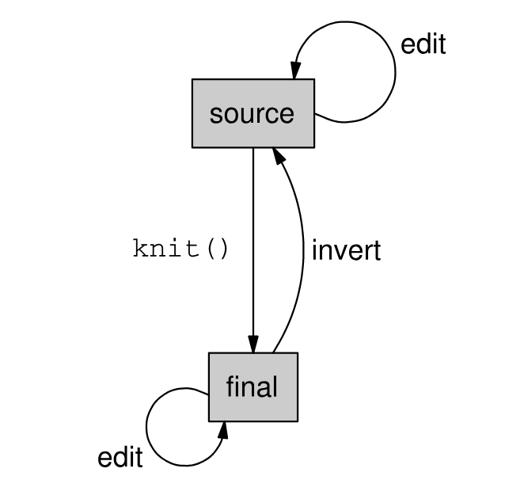
The Third Path: Attempting to Move the Earth

Slide 13

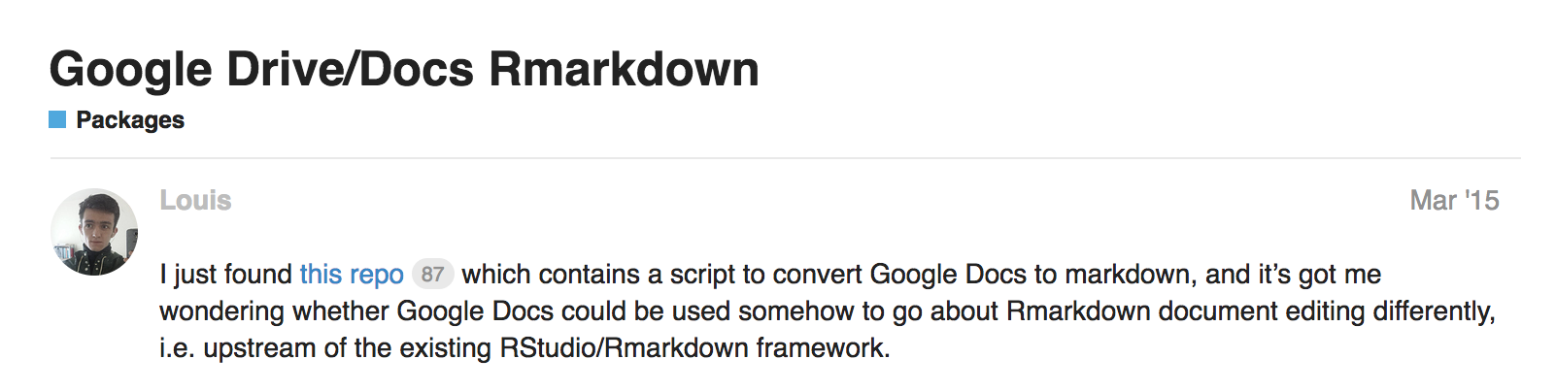

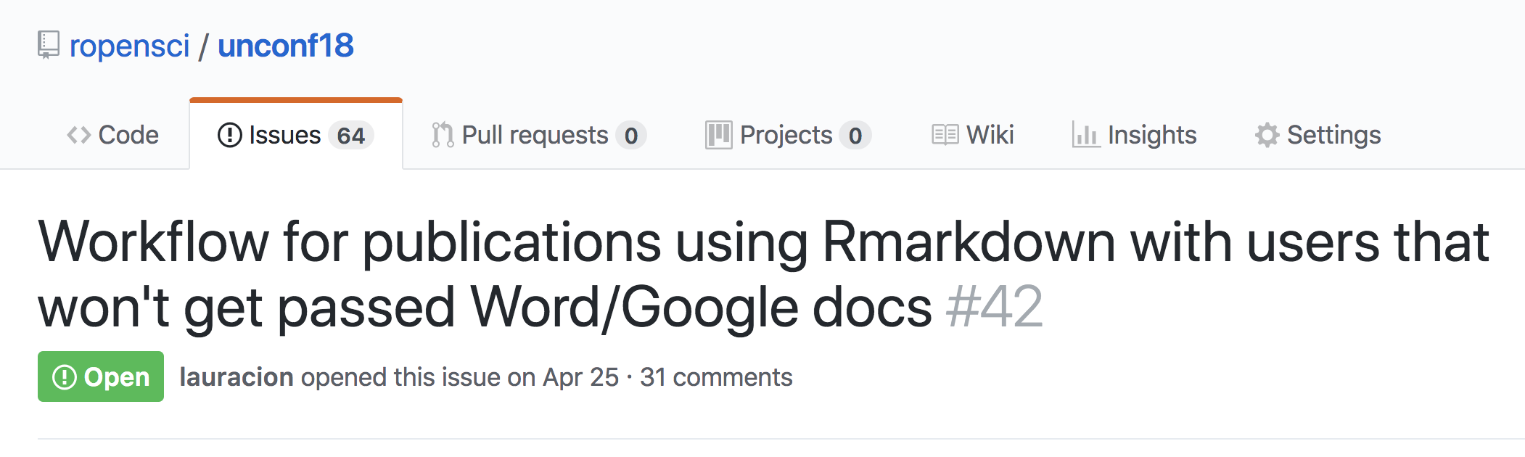

Slide 14
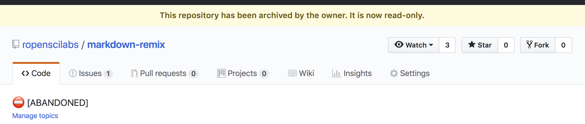


Slide 16
Avoiding the Valley of Heartbreak
Reduce your round-trips
Make them as short as possible!

Slide 17
The Officeverse
officer
rvg
flextable
mschart
rmarkdown
pandoc
or, the gohelverse:
David Gohel (@DavidGohel)
Notes:
mostly by David Gohel

Slide 18
Reduce your Round-trips:
Tasks are trapped on your side of the valley
“Can you please make the points blue?”

Slide 19
Reduce your Round-trips:
Tasks are trapped on your side of the valley
“Can you please make the points blue?”
Empower your audience
Use rvg for plots, flextable for tables

Slide 20
Shorten the Journey
Tasks repeat after each iteration
“Please update the formatting on the new version”

Slide 21
Shorten the Journey
Tasks repeat after each iteration
“Please update the formatting on the new version”
Reach further across the valley
Use rmarkdown and officer for more refined reports

Slide 22
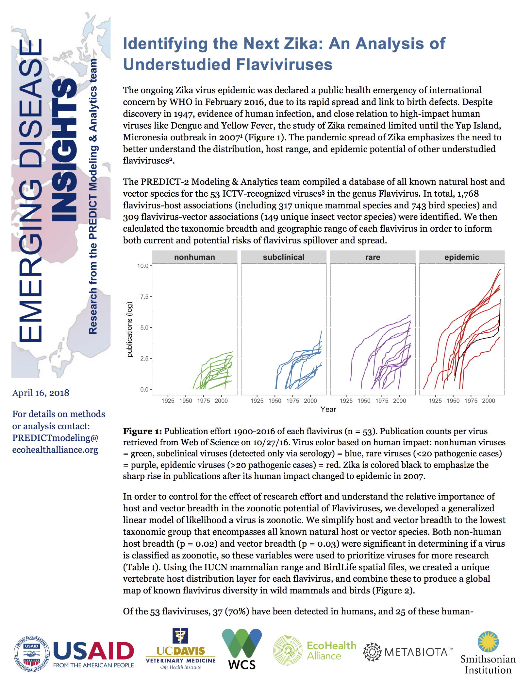
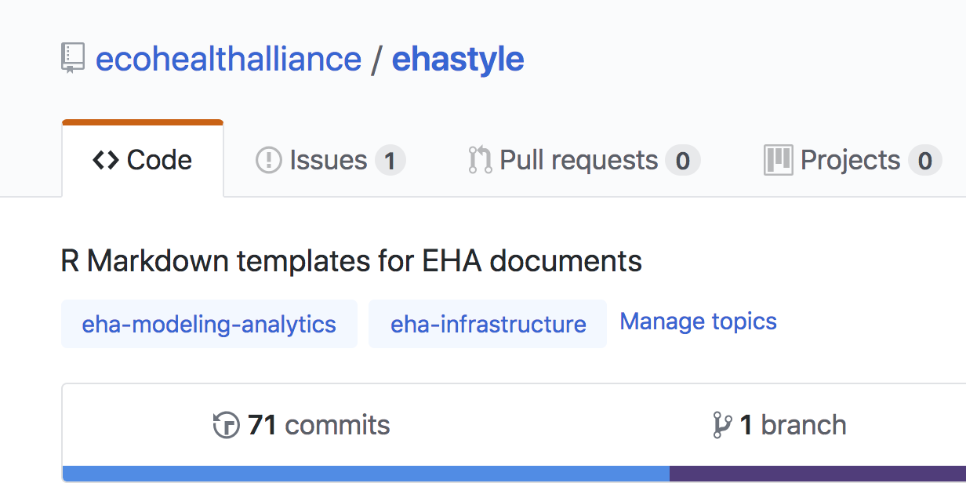

Slide 23
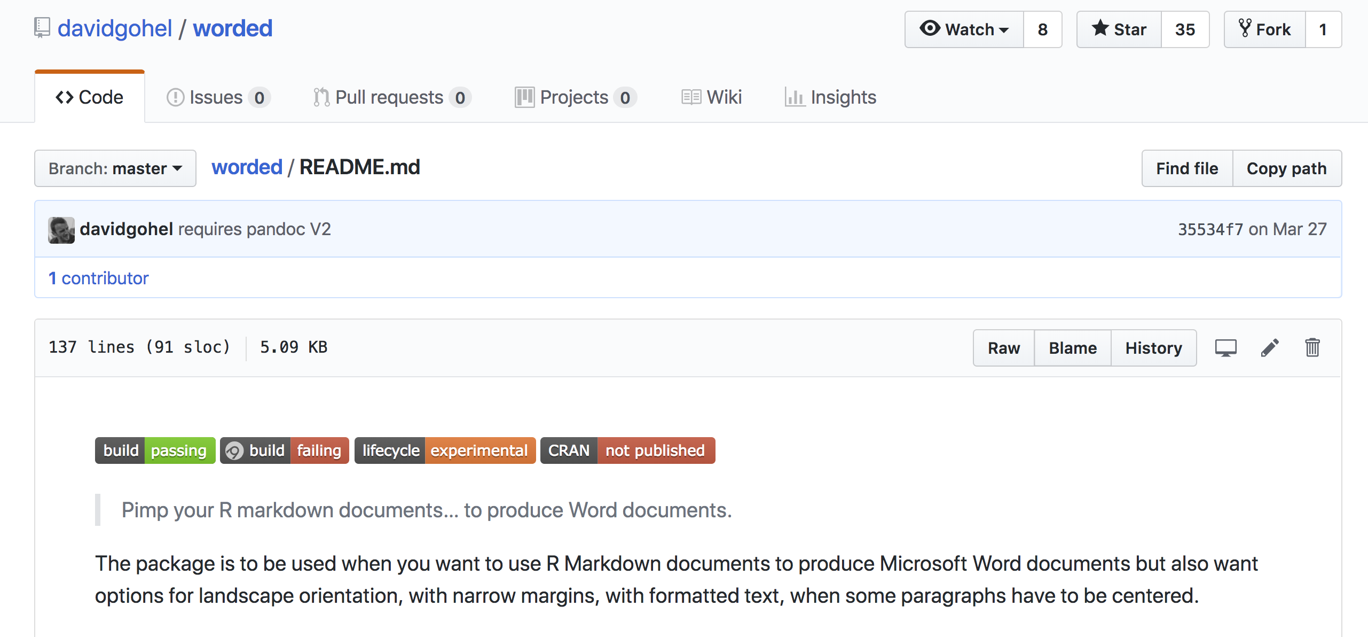

Slide 24
So…
Each realm or workflow has its place
Know your audience and output
Don’t (re)-invent grand frameworks
Smooth the paths between realms

Slide 25
Thank you!
@noamross
@EcoHealthNYC
@rOpenSci

